Slide 1
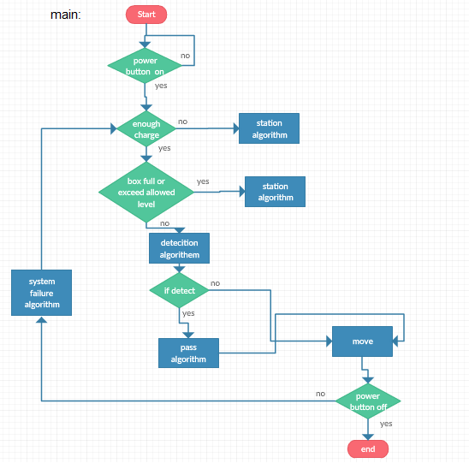
Street Cleaning Robot
Wajieh Assi, Renad Anboisi, Swer Daraghmeh
Supervisor: Prof. Mohammad Awad
CSE
Faculty of Engineering and IT
Arab American University
Introduction:
Producing a smart cleaner robot will help in fulfilling the collection of these wastes and it would, in fact, make it easier for the municipalities to have a clean city. This cleaning robot would end the fixed times for garbage collection and improve waste management since they are designed to work in urban places.
This proposed cleaning robot will be able to work on closed roads which need to be cleaned out of rubbish; it will be designed to clean the rubbish by itself in closed places.
Proposed project
This project introduces a car without a driver, without workers and clean the streets easily and fast. Moreover, the problems of narrow, small places and edges that are difficult for the workers to clean up, helped to raise the idea of this robot to solve these problems. The flexible shape of the robot allows it to clean these places quickly and easily. It also reduces the cost through the feature of this robotic identifies different places that have holes and identifies places which may need to repair. It also sends notifications with pictures to the manufacturing center. This means solving the problem at the beginning with a little money before it grows up and needed more effort and money.
System Design and Implementation:
At first, the system checks the status, power and the box of the Dust Clean. Then, the system determines if the robot is able to move. Next, after the findings of the previous steps, the system decides the right algorithm to work.
Finally, when the robot starts working, it will move in its direction and if it discovers any object, the detection algorithm will be activated and it determines the place of the object and if it is necessary to pass it or not. Moreover, the passing algorithm decides how will the system pass the object? And how the robot will go back to its track? In addition, the failure algorithm starts working if the robot will face a breakdown. So this robot will use these series of algorithms over and over.
Project Objectives:
To develop a road cleaning using modern techniques that facilitate the cleaning process.
This robot will be able to avoid obstacles using image recognition
3. The system also provides a “GPS technology” that gives the current location of the machine and make the detecting process easier.
Results:
The benefits of the " Street_ cleaning using smart robot”:
- Safely Working because it has a computer vision.
- Detecting the places that are needed to be repaired.
- Cleaning the narrow places because of its shape and its brushes.
- Working continuously because of charging itself and empty the box alone.
Project Block Diagram:
h

