Slide 1
Comparison of PDE-based, Gaussian and Wavelet Approaches for Enhancing PET Images
By:
Abeer Mohtaseb
Najla Bazaya
Oraib Horini
Supervised by:
Dr.Musa Alrefaya

Slide 2
Contents:
Introduction
Study Objectives
Study Importance
Methodology
Study Schedule
Image De-noising

Slide 3
Introduction
The PET image which use to diagnose the cancer disease suffer from noise, this leads to misdiagnosis.

Slide 4
Study Objectives
This research aims to make a comparison between filters which may use in de-noising for PET image to study the effects of the filters to enhance the PET medical image in order to achieve ideal image to detect diseases.

Slide 5
Study Importance
Helping physicians for better diagnosing patients using PET image .
Decrease the false positive and false negative results.

Slide 6
Methodology
Demonstrate qualitative and through simulations.
The validation of the proposed filter employs simulated PET data of a slice of the thorax.
The used methods for comparing the filters results are: PSNR, NR, and correlation.

Slide 7
Image De-noising
Noise: is undesired information that contaminates the image.
De-noising: is the first step to be taken before the images data is analyzed.

Slide 8
Image filtering
Gaussian Filter .
Wavelet transform .
Anisotropic Diffusion Filter .
Mean Curvature Motion .

Slide 9
Gaussian Filter
Done by convoluting each point in the input array with gaussian kernel then summing all to produce the output array.
Gaussian for 2D:
$G\left(x,y\right)=$ $\frac{1}{2πσ^{2}}e^{− \frac{x^{2}+y^{2}}{{ 2σ}^{2}}}$
σ : standard deviation.
High σ leads to a higher degree of smoothness.

Slide 10
Wavelet transform
Represents a signal as a sum of translations and dilations of a band-pass function.
A signal $f\left(x\right)$ can be decomposed using multi resolution analysis:
$$f\left(x\right)= \sum_{k}{\sum_{j=1}^{J}{d_{j}\left(x\right). }}ѱ_{j,k}\left(x\right)+ \sum_{k}{C_{J}\left(k\right).}ϕ_{J,k}(x)$$

Slide 11
Anisotropic Diffusion Filter
Perona and Malik Equation:
I (t) = div(c (t, x, y) delta I)
c (t, x, y) is the edge stopping.
x is the gradient magnitude.
But when c(t, x, y) = 1..Whats happened??

Slide 12
Cont..
Perona has improved it and give an image function g(x):
g(x) = 1/1+(x/k)(x/k)
Or
g(x) = exp((x/k)(x/k))
K:control the sensitivity to edges.

Slide 13
Mean Curvature Motion
By curve (u)(x), we denote the curvature, i.e. the signed inverse of the radius of curvature of the level line passing by x. When Du(x) 6= 0, this means :
curve(u)=$\frac{uxxu2 y − 2uxyuxuy + uyyu2}{(u\frac{2}{x}+u\frac{2}{y})\frac{3}{2}}$

Slide 14
Quantitative Evaluation Measure
1. Peak Signal-to-Noise Ratio (PSNR):
Is the ratio of a signal power to the noise power.

Slide 15
Cont..
2. Noise Variance (NV):
describes the remaining noise level .So, it should be a small as possible.
How will we estimate the noise variance?
Noise variance = Variance of the image

Slide 16
Cont..
3. Correlation:
Correlation between the image and the correlation filter, the better quality when this correlation is high.
$F ° I\left(x, y\right)= \sum_{j=−N}^{N}{\sum_{i=−N}^{N}{F\left(i, j\right) I\left(x+i, y+j\right)}}$
Where F: is a Correlation Filter.
I: image.
And i, j are denote to the position in image and in correlation filter.

Slide 17
Implementation & results

Slide 18
De-noising quality measure (FBP PET image reconstruction)
 | Noise fbp | Perona & Malik | Gaussian | Wavelet | Curvature
PSNR | 12.1155 | 21.9530 | 16.9102 | 18.6044 | 22.9178
Correleion | 0.6922 | 0.9681 | 0.9323 | 0.9591 | 0.9673
NV | 0.0696 | 0.0236 | 0.0971 | 0.0850 | 0.0238

Slide 19
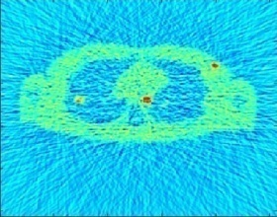
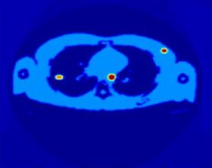
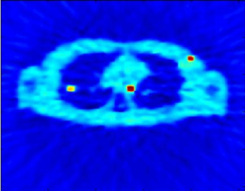
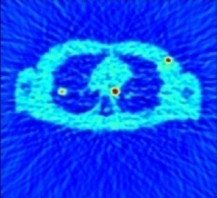
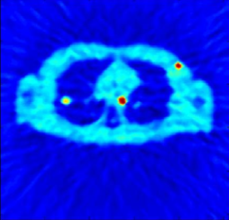
FBP PET image reconstruction
Noise image Original image
Perona Gaussian Curvature Wavelet

Slide 20
De-noising quality measure (OSEM PET image reconstruction)
 | Noise osem | Perona& Malik | Gaussian | Wavelet | Curvature
PSNR | 22.9196 | 32.5611 | 21.5641 | 21.7255 | 27.4822
Correlation | 0.7948 | 0.9805 | 0.9777 | 0.9786 | 0.9701
NV | 0.0652 | 0.0216 | 0.0758 | 0.0743 | 0.0367

Slide 21
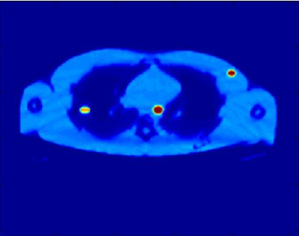
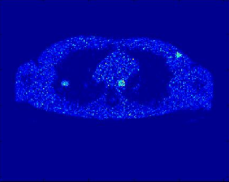
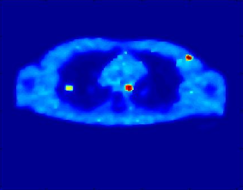
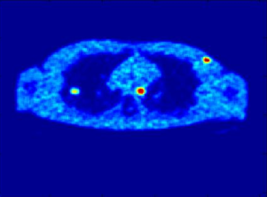
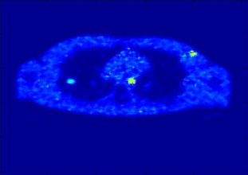
OSEM PET image reconstruction
Noise image Original image
Perona Gaussian Curvature Wavelet

Slide 22
Conclusion
PDE-based filters (Perona & Malik and CCM) are the best.

Slide 23
Recommendation
Our team recommended increasing the number of filters in the comparison process to get the better de-noising result of the PET as possible.

Slide 24
References
[1] Goldberg, A, Zwicker, M, Durand, F. Anisotropic Noise. University of California, San Diego MIT CSAIL.
[2] Shidahara, M, Ikomo, Y, Kershaw, J, Kimura, Y, Naganawa, M, Watabe, H. PET kinetic analysis: wavelet denoising of dynamic PET data with application to parametric imaging. Ann Nucl Med. 21. 379–386. (2007).
[3] Greenberg, Sh and Kogan, D. Anisotropic Filtering Techniques applied to Fingerprints. Vision Systems - Segmentation and Pattern Recognition. 26. 495-499. (2007).
[4] Gerig, G, Kubler, O, Kikinis, R and Jolesz, F. A. Nonlinear Anisotropic Filtering of MRI Data. IEEE TRANSACTIONS ON MEDICAL IMAGING. 1(2). 221-224. (1992).
[5] Olano, M, Mukherjee, Sh and Dorbie, A. Vertex-based Anisotropic Texturing.

Slide 25
Summary

Slide 26
Thank You

