Slide 1

Palestine Polytechnic University
Braille To Text/Voice Converter
Project Team
Wisam Younes Bayan Halawani Samer Isieed
Project Supervisor
Dr. Radwan Tahboub

Slide 2
Outline
Abstract
Project Objectives
About Braille (Briefly)
Conceptual Block Diagram
Braille Paper
Image Processing Technique
Suggested Algorithm For Skewed Image
BT/VC Algorithm
Cell/Dot Recognition
Use Cases
Sequence Diagram
Results
Conclusion
Future Work

Slide 3
Abstract
The Braille to Text/Voice Converter (BT/VC) is a system that designed to help sighted people to be able to understand Braille script without any knowledge in Braille.
The aim of this project is to develop a system that is able to translate a Braille script into multilingual script and represents the converted script as text or voice to the user using mobile application.

Slide 4
Project Objectives
Reduce the gap between blind and sighted people.
Help teachers to teach blind students.
Help the parents to keep track of their blind child’s study.
Design a system that is portable, flexible and easy to use.

Slide 5
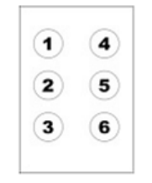
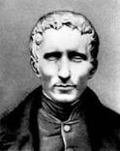
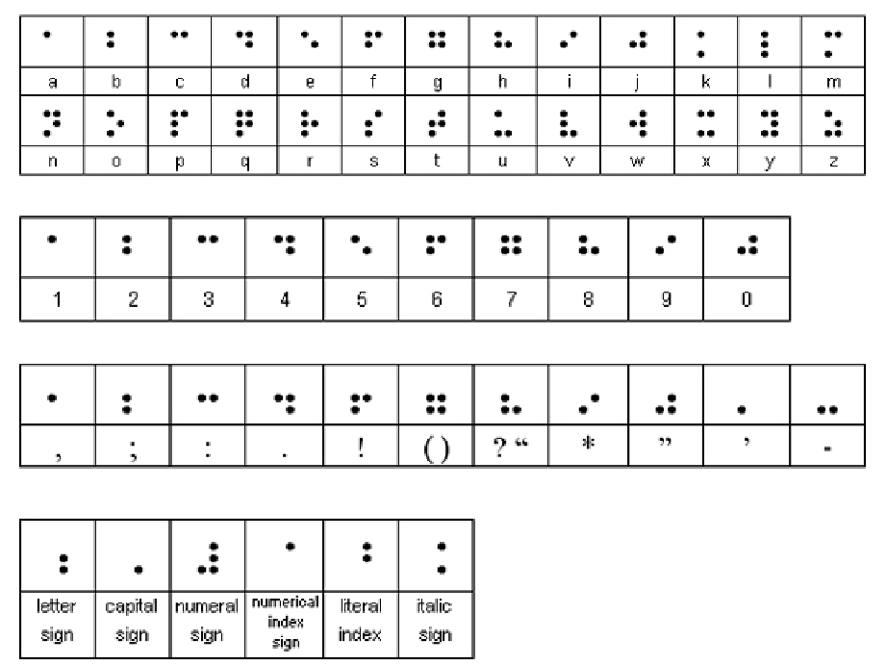
About Braille
Braille is a language that is used to read and write by blind people.
Founded by “Louis Braille”
Braille cell
Grade 1

Slide 6
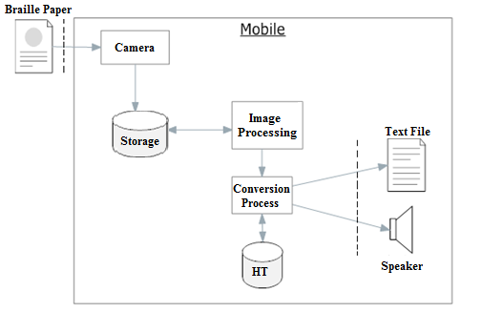
Conceptual Block Diagram

Slide 7
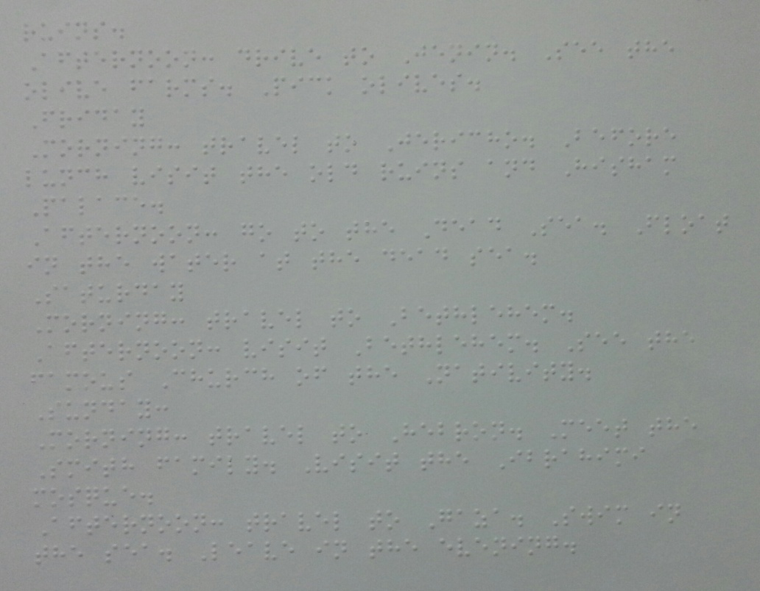
Braille Paper as Image

Slide 8
Image Processing Techniques
Converting image from RGB to Gray scale.
Separate the dots from the background.
Enhance the image using Morphology techniques.

Slide 9
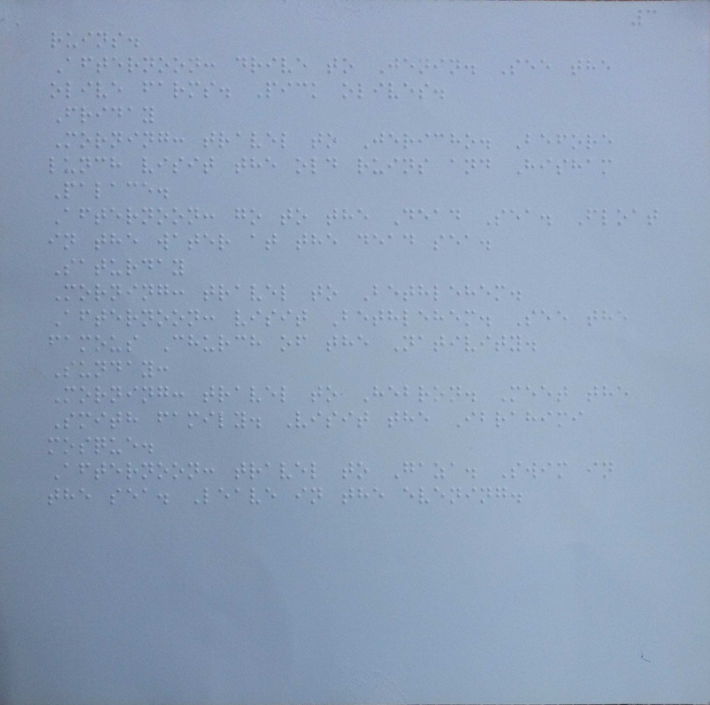
RGB to Gray Scale Image
RGB
Gray Scale

Slide 10
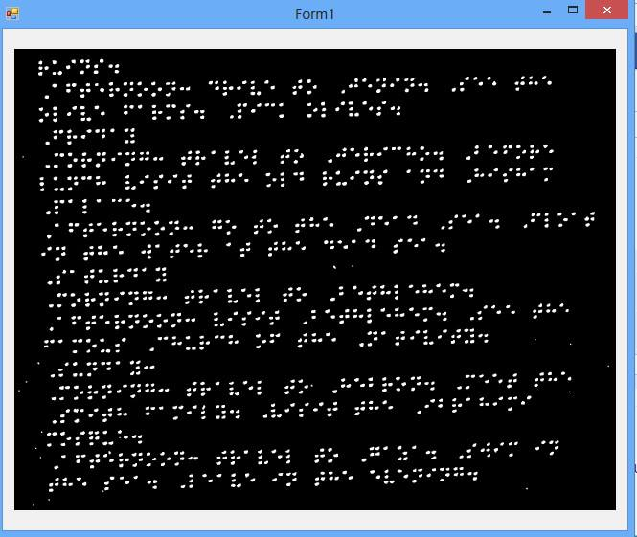
Separate the Dots From the Background
Done using adaptive thresholding .
Changes the threshold dynamically over the image

Slide 11
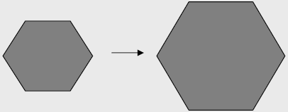
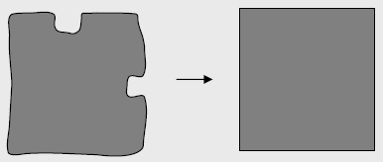
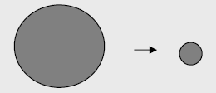

Morphology Technique.
Dilation
Erosion

Slide 12
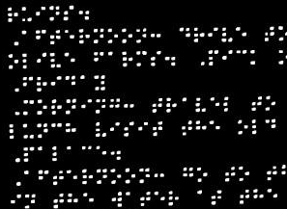
After Applying the Morphology Technique

Slide 13
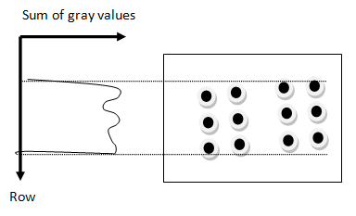
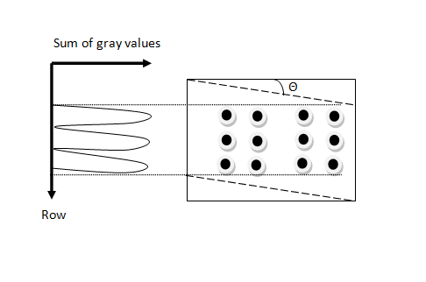
Suggested Algorithm for Skewed Images
A suggested solution for this problem is to find the sum of rows on a Braille cell, after that the image is rotated with a small angle

Slide 14
BT/VC Algorithm
Xd
w
Left top corner(x,y)
11
4
11
4
1
4
CenterX =x+ 0.5*w.
CenterY =y+ 0.5*h.
hw=0.5*w - d.
hh=0.5*h - d.
Dot1: (centerX-hw,centerY-hh)
Dot2 : (centerX-hw,centerY)
Dot3 : (centerX-hw,centerY+hh)
Dot4: (centerX+hw,centerY-hh)
Dot5: (centerX+hw,centerY)
Dot6: (centerX+hw,centerY+hh)
2
5
2
5
h
2
5
Yd
3
6
3
6
3
6
11
4
2
5
3
6

Slide 15
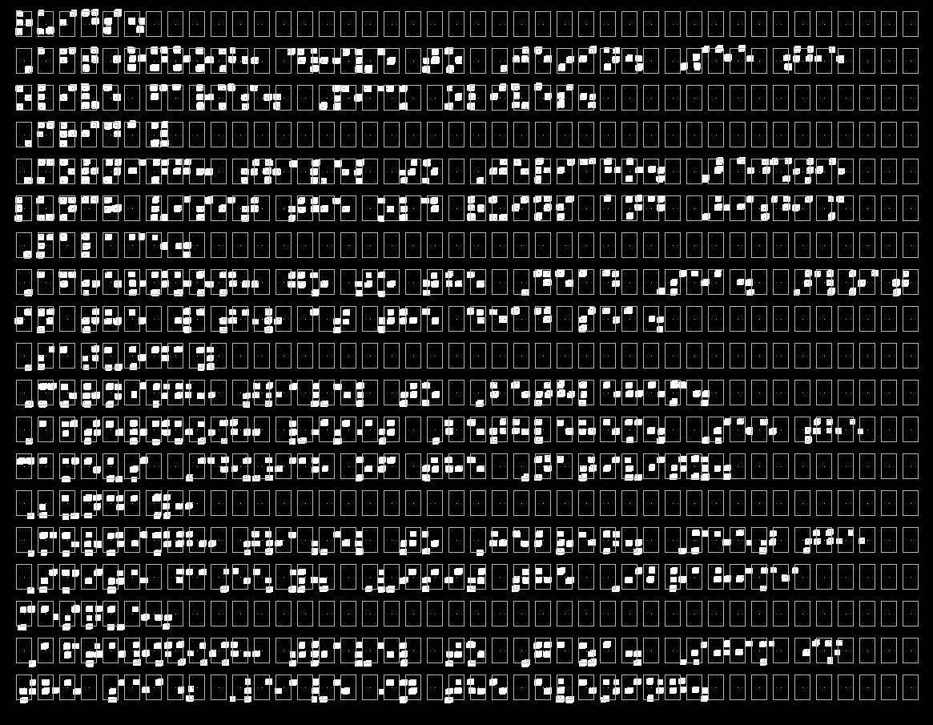
Applying BT/VC Algorithm

Slide 16
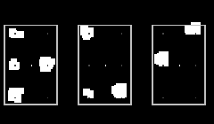
Cell/Dot Recognition
After we applied the previous algorithm, we got the following “sample”:
Consider we have these three cells
Export a binary code for each one.
Cell 1 : 111010.
Cell 2 : 101001.
Cell 3 : 010100.
Then using the Hash table we can get the ASCII Code for each of the previous binary code

Slide 17
Use Case Diagram
User

Slide 18
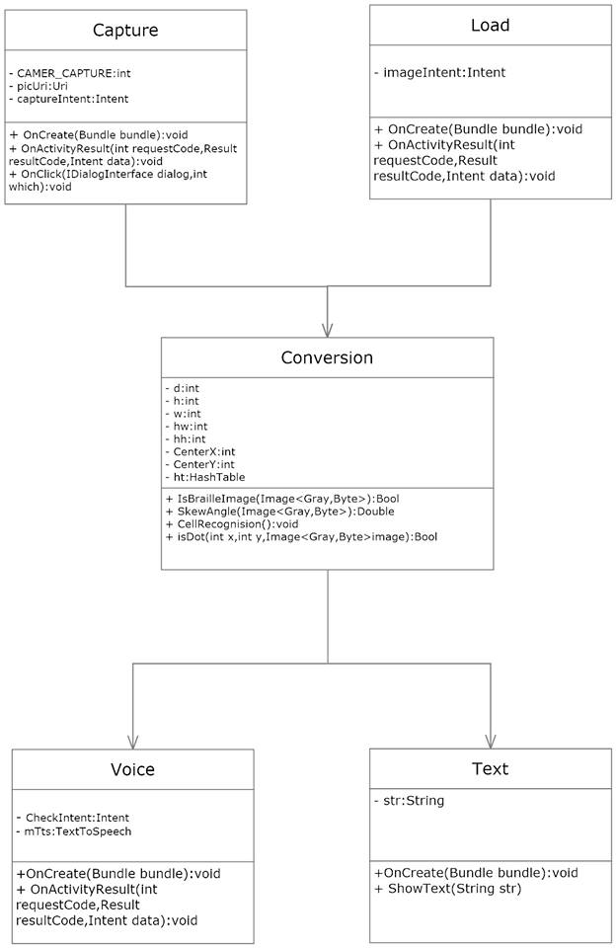
UML Diagram

Slide 19
Results
According to the three Braille samples that have been tested in different situations using BT/VC algorithm. The following table shows the results that have been recorded during testing stage.
Sample State | Ideal Image | Ordinary | Skew Algorithm | Scanned | Sparse Data
Average(%) | 99.6 | 59.3 | 66 | 78.3 | 94

Slide 20
Conclusion
Dealing with images in term of image processing issue it is not an easy task.
Braille image is a sensitive image, which means it should be captured under a suitable situation in order to get a good results.
It is possible to program an application for android using C# instead of JAVA and we decide to use C# because it is faster than JAVA.
Adaptive thresholding technique that has been used to separate the Braille dots from the background is an effective technique and it gives a very good result for more than 90% from the images.
Morphology techniques can help to enhance the image from a noise.
The captured image always has a skew angle( or the image has a rotated angle in 3rd axis).

Slide 21
Future work
Supporting multilingual scripts
Improving the suggested algorithm for the skewed image
Improving BT/VC algorithm
Having more collaborative user interface

