Slide 1
Faculty of Engineering Civil Engineering Department ENCE530- Graduation project 2012-2013

Slide 2
Olive Mill Waste Water Management
By :
Wala’ Abd Allah (1081023 )
Samar Salameen(1081315)
Supervised by : Dr.Omar Zimmo

Slide 3
Introduction
In Palestine ,the problem of untreated OMW discharge is urgent .
Several hundred thousands cubic meters of untreated W.W is discharged into open areas and cesspools .
The current project addresses this issue by relatively basic treatment scheme that can be implemented to olive mill sites for little cost with valuable end products.

Slide 4
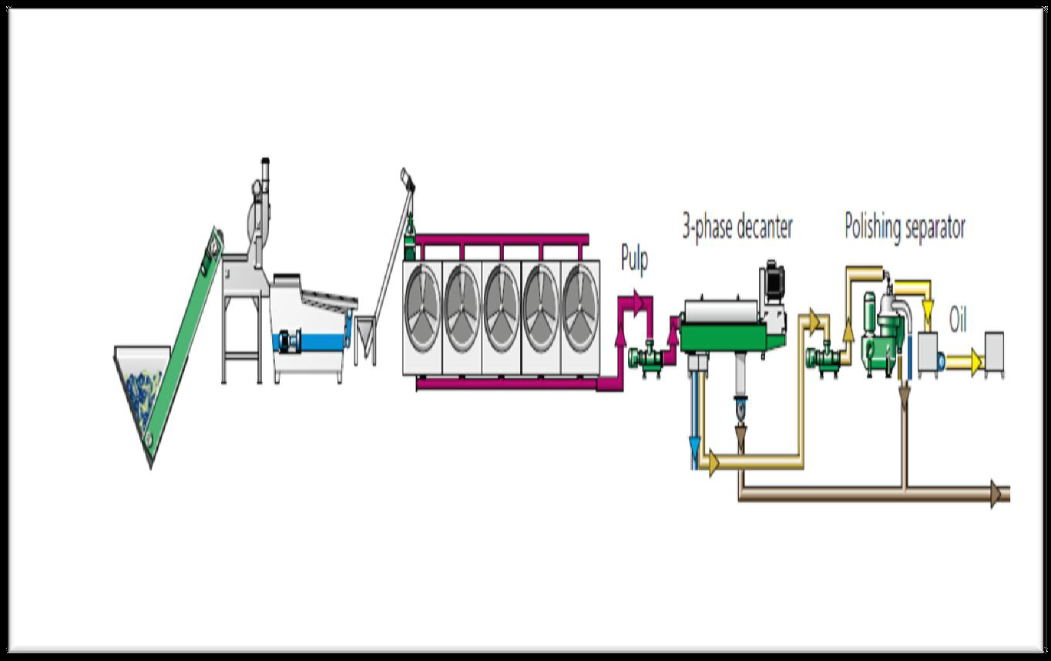
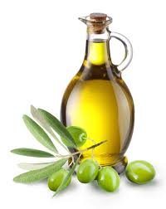
Olive mill by product
Olive oil
Olive cake
Olive mill waste water

Slide 5
Olive mill owners questionnaire
Main Objectives
Olive presses distribution according to operational status, and level of automation.
Quantity of olive mill waste production of jeft and zebar.
Number of employees and the mill working hour.
Olive pressing costs.
Coverage area of the mill and additional available area for construction a treatment plant.
Olive mill waste water management level.

Slide 6
Analysis of results
The majority of the olive-mills is located within the residential areas ,land areas ranges between 170-3000sqm.
38% of the olive mill has excess area around the facility.
The production of olive mills waste (zebar and jeft ) varied widely ,due presence of other competitors and variation in the amount of pressed olives
None of the surveyed mills implement a management plane for OMWW.

Slide 7
Cont’d

Slide 8
OMWW characterizations

Slide 10
Choice and laboratory scale evaluation of a biological treatment method for olive mill wastewater

Slide 11
OMWW proposed treatment process

Slide 12
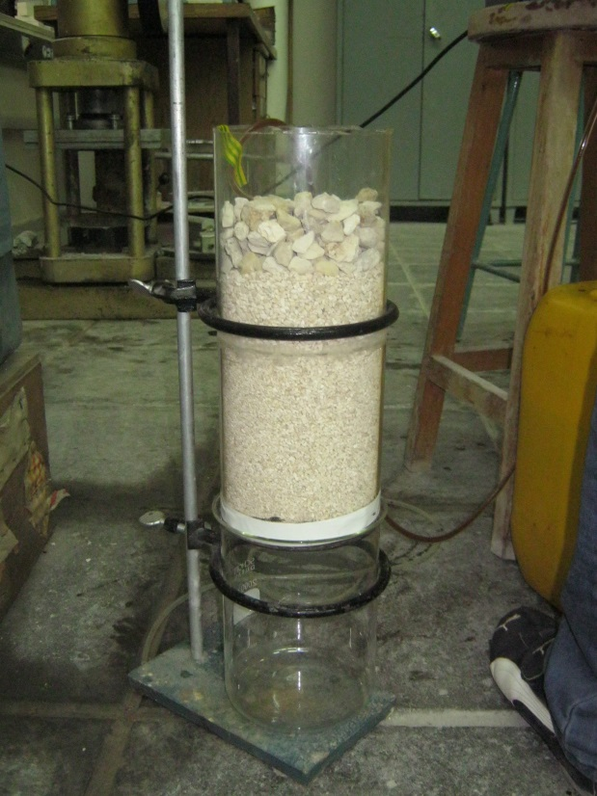
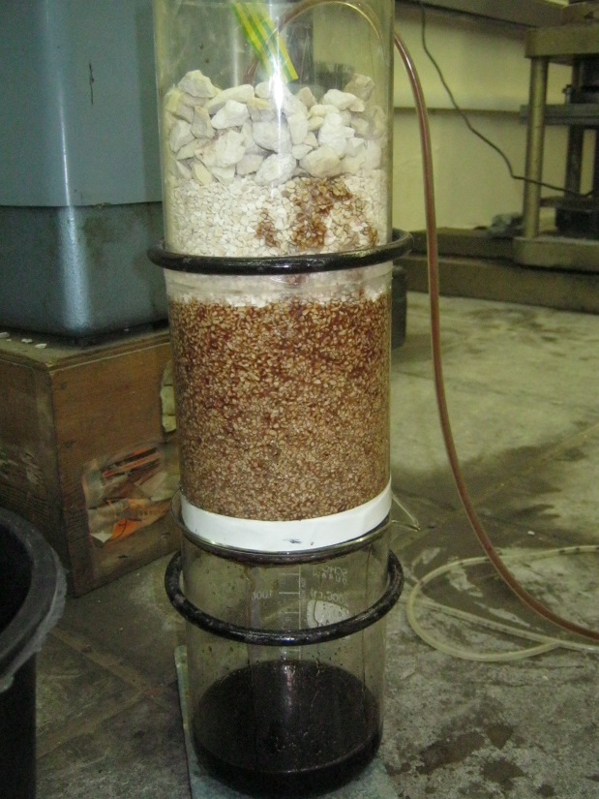
Laboratory experimental setup
Phase I:physical treatment (gravel filter)

Slide 13
Phase II: Biological treatment
The performance of two systems had been evaluated :
Trickling filter system.
Activated sludge system

Slide 14
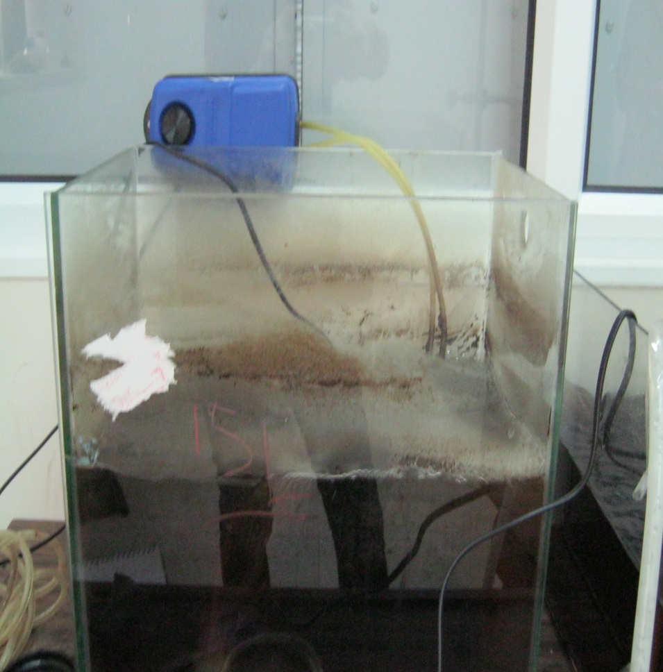
Activated sludge system

Slide 15
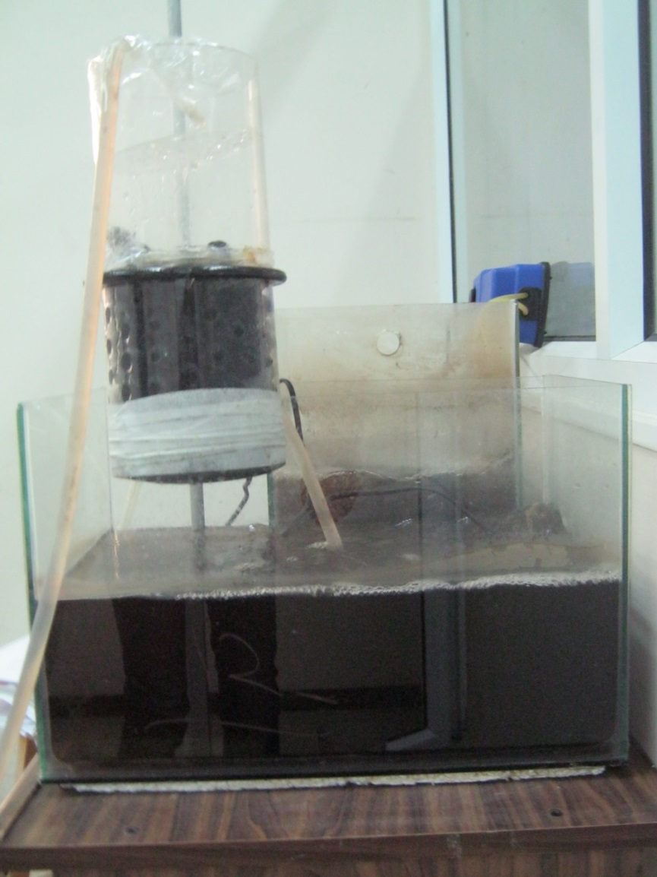
Trickling filter

Slide 16
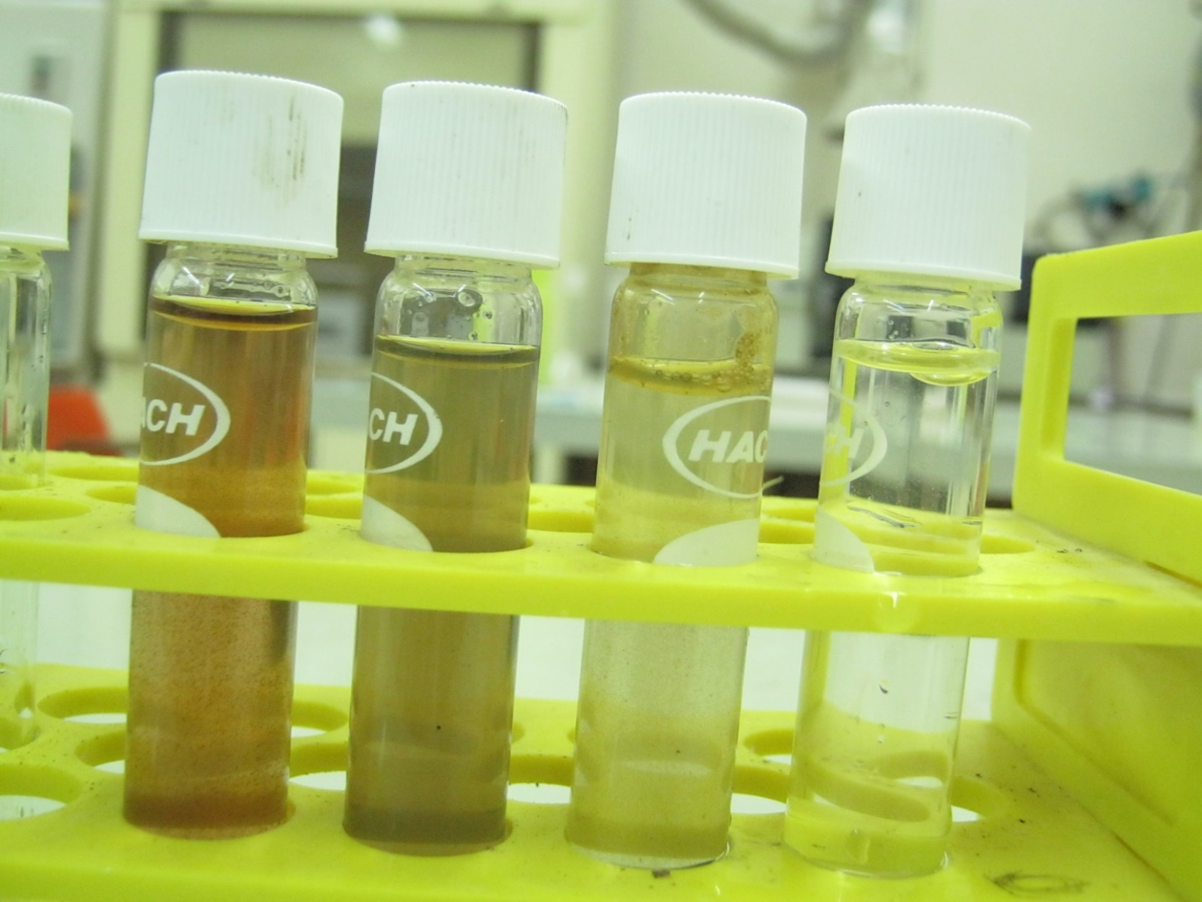
Color removal

Slide 17
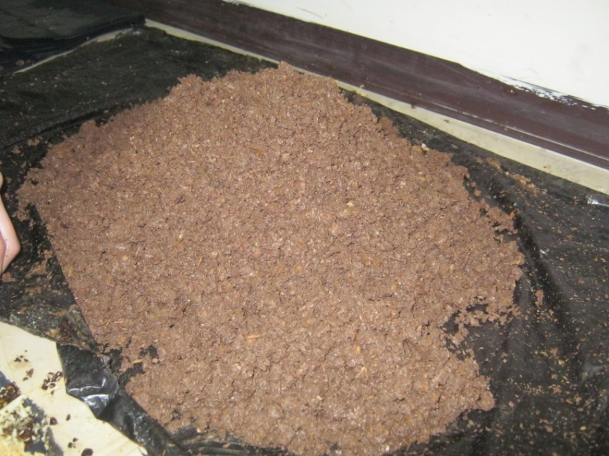
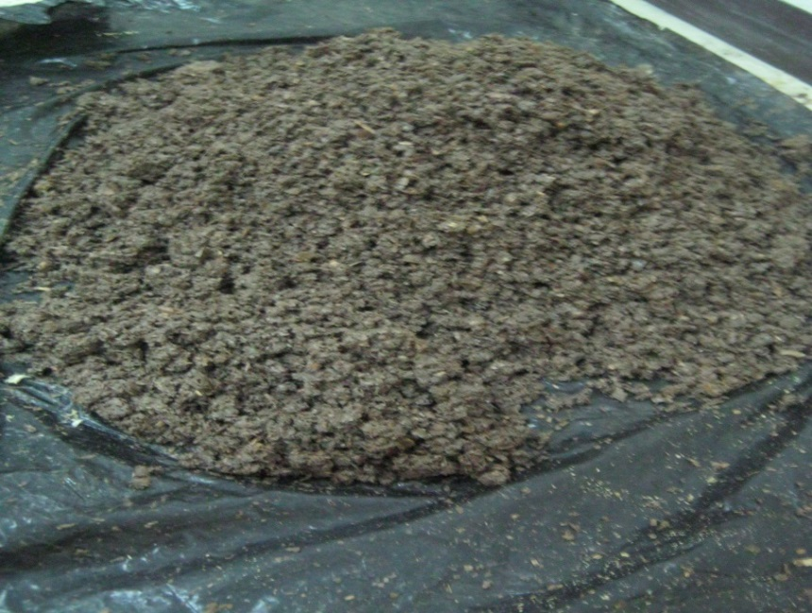
Composting

Slide 18
Analysis of results
Sand filter
TSS removal efficiency vs. Time

Slide 19
Analysis of results
Trickling filter
Activated sludge system

Slide 20
C=C˳[f + (1-f) e^-kt]
Trickling filter
K = | 0.535
F1 = | 0.249
F2 = | 0.223
F3= | 0.254

Slide 21
Cont’d
Activated sludge system
K = | 0.303814
F1 = | 0.181005
F2 = | 0.235416
F3 = | 0.219805

Slide 22
Conclusion
Because the 3-phase system the dominant method for olive oil extraction, very large amounts of liquid wastes is producing every season.
None the olive mills implement a management plane for OMWW.
This study shows olive mill waste was treated in circulating pond /T.F system, with a K=0.535, or within the activated sludge system with K=0.304.this suggesting strong treatment feasibility.

Slide 23
T.F/recirculating pond system found to be more applicable in the olive mill, this is because of low operating cost, low labor skill requirement.
the treatment of mill waste stream can be carried out at rural site by separation of the liquid from the solid, solid is to be composted and the liquid to be treated by a recirculating pond and trickling filter system.

Slide 24
The proposed OMW treatment plant

Slide 25
Recommendations
The olive mill waste disposal problem has two levels, the management level and the other is the technical level.
A well management plan has to be established, focusing on the following points:
cooperation between authorities ,have to be achieved in
a manner to enforce OMWW treatment before discharge it
Providing training courses for the farmer and the olive mill owner ,to increase the level of awareness of the significant impact of the problem

Slide 26
The back washing of the gravel filter is hard and high water consuming process.
The phytotoxicity of the treated OMWW has to be determined precisely to grantee the Consistency with the Palestinians standard for irrigation water.
The olive washing water could be screened and then used in the treatment plant for dilution purposes.
Initial Feasibility study of the project must be established. Also centralized decentralized treatment option must be considered.

Slide 27
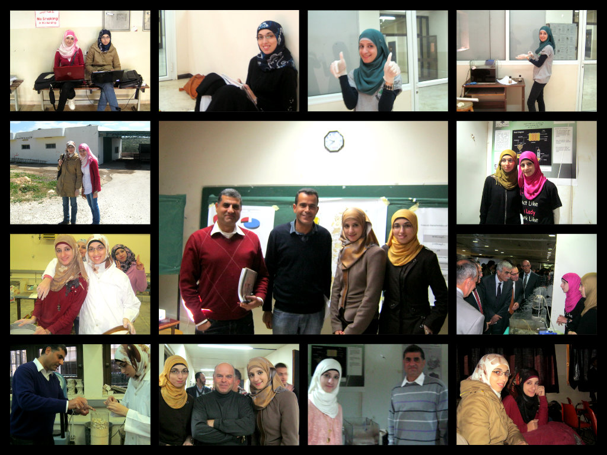
Any questions ?!
Thank You

