Slide 1


Palestine Polytechnic University
Electrical and Computer Engineering department
Welcome To
Intelligent Traffic With Automatic Violation System
[ITWAVs]
Abdullah Z. Ja’abary Hassan A. j’afreh Khalid I. Baradia Mustafa F. Zaitown

Slide 2



Supervisors :
DR. Murad Abusbaih
DR. Zuhdi Salhab

Slide 3
في العجلة الندامة وفي التأني السلامة

Slide 4
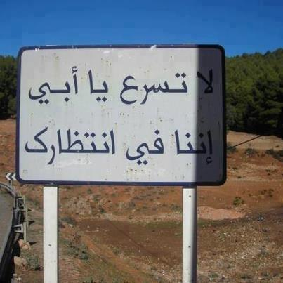

Slide 5
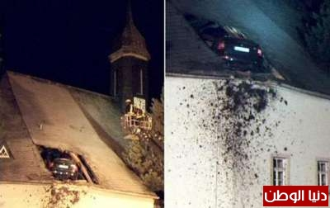

Slide 6


Slide 7
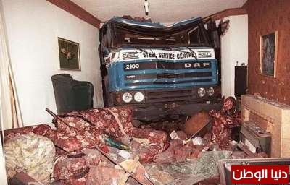
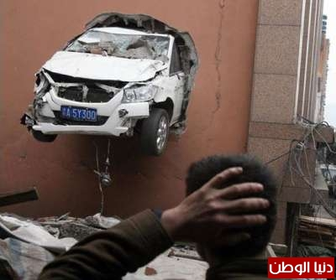

Slide 8
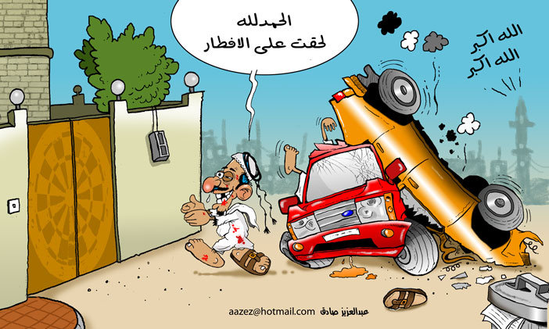

Slide 9
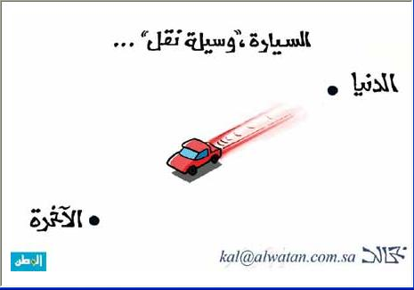

Slide 10





من شهداء حادث جبع ..
عبدالله الهندي
ميلاد سلامة
لميس حمدان

Slide 11

Driving more than the speed limit of the street, causes the proportion of 71% of fatal traffic accidents.
Traffic accidents recording more than 1.2 million people in the world dead every year
SO, What is the solution????

Slide 12
Intelligent Traffic With Automatic Violation System
[ITWAVs]

Slide 13

Contents:
Main block diagram
Video about our system
System flow chart
Entity-Relationship Model ( ER Model )
Set up mode flow chart
GPS data flow chart
Server flow chart
Crashing system
Literature review

Slide 14
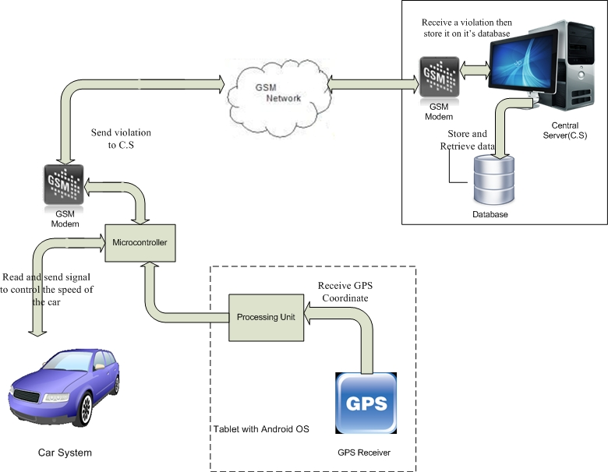
Main block diagram

Slide 15
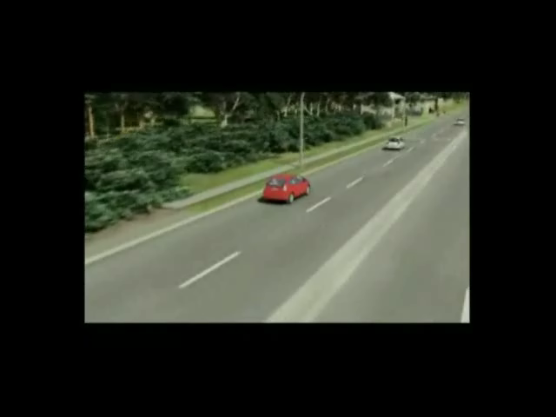

Slide 16
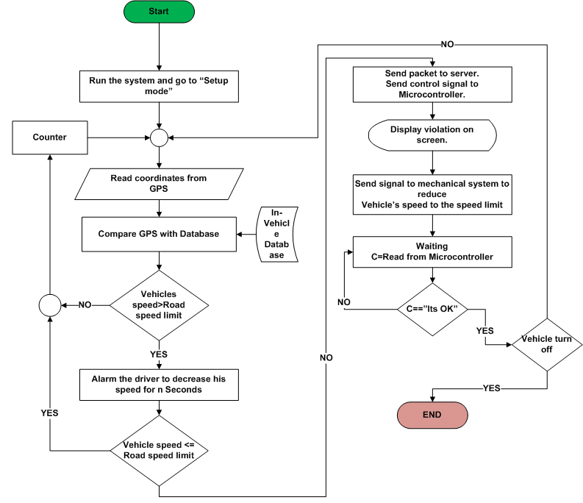
System
Flow Chart

Slide 17
Set up mode flow chart

Slide 18
Get GPS data flow chart

Slide 19
Server flow chart

Slide 20
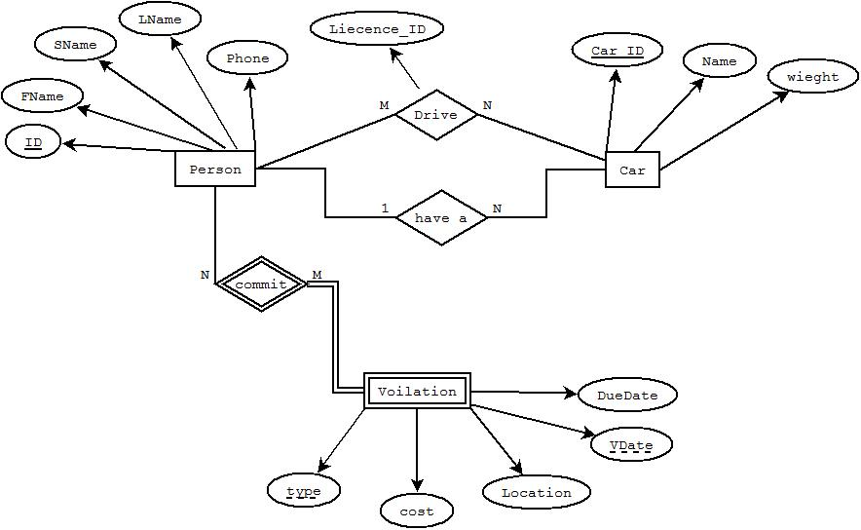
Entity-Relationship Model ( ER Model )

Slide 21
Crashing System

Slide 22
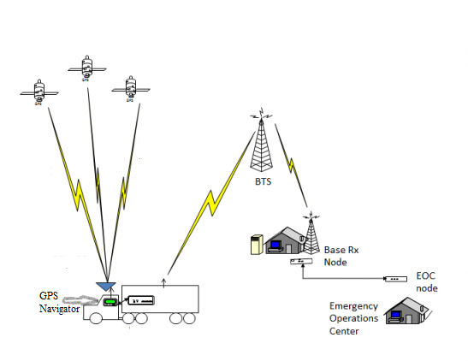
Crashing flow chart
Crashing System Block diagram

Slide 23
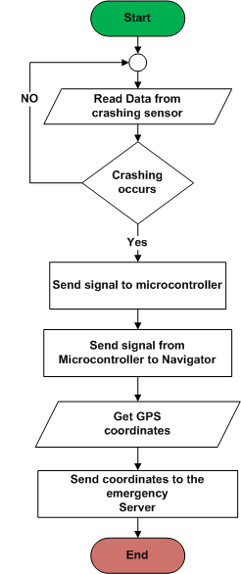
Crashing System
flow chart

Slide 24
Microcontroller flow chart

Slide 25
Literature review
1- Vehicle Information and Communication System (VICS)
This system use road side beacon unit , which is a transmitter device located on the speed limit sign , this unit transmit signals contain information regarding the road speed limit.
2- Active Distance Support system (ACDIS)
This system using the distance sensor located in the nose of vehicle, and this supports longitudinal guidance .
(3- Intelligent speed adaptation (ISA
This system used GPS receiver with roadside beacons , it’s the same as VICS system but it contain GPS receiver to match the coordinate that received from roadside beacons .

Slide 26

Thank you

