Slide 1

Thermoluminescence dosimetry (TLD) technology in dosimetry
Prepared by:
Haneen Mahmoud Bustange
Alaa’ Hassan Badawee
Rowayda Masallma
Project Supervisor
Dr. Ayman Swetti

Slide 2
Abstract
As a result of increased human exposure to radiation and radioactive sources there has been needed to monitor human exposure to radiation. Personnel radiation dosimetry is the science currently being used to monitor radiation exposure. A thermoluminescent dosimeter (TLD) is the device that is used to measure personal radiation dose. A TLD measures ionizing radiation exposure by measuring the amount of visible light emitted from a crystal in the detector when the crystal is heated. The amount of light emitted is dependent upon the radiation exposure. After exposure, the TLD stores the measured dose for a long period of time. There are many different types of dosimeters that are used these include bubble dosimeters, film badges, track etch detectors and pocket dosimeters. Each of these is designed for different uses, but they all perform the same basic function .also the TLD have many application and uses in day life.

Slide 3
Out line
Radiation and Dosimetry
Method of radiation doses
Thermoluminescent Dosimeters
Fundamental Concepts
Dose concepts
About dosimeters

Slide 4
Thermoluminescence Dosimetry
A general model .
The mechanism of TL dosimetry
TLD Reader
TLD Materials
Basic concepts :
Applications of TLD
Conclusion
Advantages and disadvantages of TLDs

Slide 5
Radiation and Dosimetry
In physics, radiation is a process in which energetic particles or energy or
waves travel through a medium or space.
Dosimetry is the act of measuring or estimating radiation doses and assigning
those doses to individuals. require licensees to control doses to workers and
to the public and to ascertain these doses.
Radiation dosimetry is defined as the measurement, usually, of the absorbed
dose, or other relevant quantities like KERMA, exposure or equivalent dose,
which is produced due to the Interaction of the ionizing radiation with a
material. That measurement can be achieved using a dosimeter . A dosimeter
with its reader is called a dosimetry system .

Slide 6
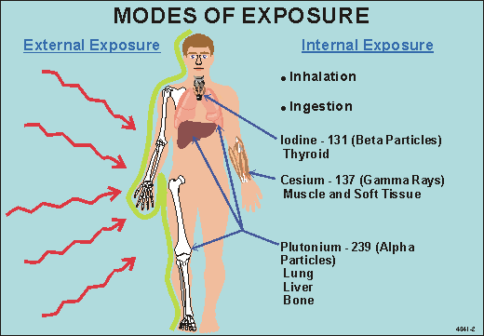
People are exposed to radiation in mainly two modes:
1. From radiation sources outside the body (external exposure).
2. From radioactive substances that are inhaled or ingested into the body
(internal exposure).
Figure 1: The external and internal models of exposure.

Slide 7
Method of radiation doses
Method of radiation doses
Personal Dosimetry
Indirect monitoring using
measured dose rates or
airborne concentrations
of nuclear substances
Indirect monitoring using
environmental pathways
analysis
Is used primarily
to workers in the
nuclear industry.
Is used when a person
occupies an area with
a known concentration of
airborne radioactivity, or
a known radioactive field,
for a known period of time.
In this method, population
exposures are modeled by
measuring the amount of
nuclear substances released
to the environment from
a source .

Slide 8
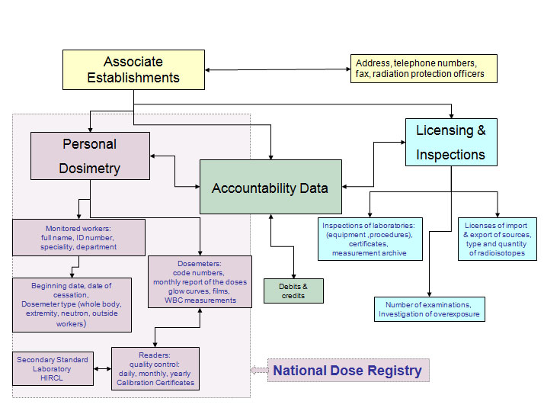
Personal Dosimetry
Figure 2: The personal dosimetry

Slide 9
Monitoring using environmental
pathways analysis
Figure 3: Environmental pathways analysis

Slide 10
Fundamental Concepts
Fundamental concepts
Structure of
the atom
Types of
radiation
Radioactive
decay
Photon (x-rays
and gamma rays)
Neutron
Alpha
Beta

Slide 11

  DOSE CONCEPTS
When ionizing radiation penetrates matter, such as the human body, it deposits
energy. The energy absorbed per unit mass from exposure to radiation is called
a dose.
Three different radiation dose quantities are : absorbed dose, equivalent dose,
and effective dose.
Figure 4 summarizes the relationship between these dose quantities .

Slide 12
Figure 4 : Relationship between absorbed dose, equivalent dose and effective dose.

Slide 13
About dosimeters
A dosimeter is a small radiation detection device worn by an individual, used
to measure doses from ionizing radiation.
Dosimeters are classified into two general categories:
A passive dosimeter produces a radiation-induced signal, which is stored in
the device. The dosimeter is then processed and the output is analyzed.
An active dosimeter produces a radiation-induced signal and displays direct
reading of the detected dose or dose rate in real time.

Slide 14
  Thermoluminescent Dosimeters
There are many types of dosimeters for measuring beta and photon radiation.
these include film dosimeters, thermoluminescent dosimeters (TLDs) optically stimulated luminescence dosimeters (OSLDs), and direct reading dosimeters (DRDs). But know we will discusses TLDs.
TLDs are mainly used for personal monitoring of workers who are exposed to
radiation that is higher than 3/10 of the dose equivalent limits. The individual
monitoring of those workers is essential in order to make sure that the limit of
the equivalent dose doesn’t exceed the maximum permissible dose .

Slide 15
Figure 5 : External exposure – Estimation of dose at depths equal to 0.07 and 10 mm

Slide 16
Thermoluminescence Dosimetry
A general model .
Luminescence is a process in which, a material that is irradiated , absorbs
energy which is then emitted as a photon in the visible region of the electro-
magnetic spectrum.
Thermoluminescence is a form of luminescence in which heat is given to the
material which results in light emission .
The mechanism of TL dosimetry discuss in figure in after slide :

Slide 17
The mechanism of TL dosimetry:
Figure 6 :The mechanism of TL dosimetry

Slide 18
The probability of a charge carrier to escape per unit time (p) is given by the
Randall-Wilkins theory using the equation:
Where:
= the mean half-life of a charge carrier in a trap .
= the frequency factor .
E
= the energy of the trap
= the Boltzmann’s constant =8.62*10^5 )eV \
(
k
T
= the Temperature

Slide 19
By increasing the temperature , the escape rate is increased and the mean
half- life of is reduced .
This rate, as it is increased, reaches a maximum at a specific temperature and then is rapidly reduced . But as the intensity of the emitted light is proportional to this rate, it could be realized, that there would be a creation of a peak in the graph of intensity versus temperature, called glow peak, and the graph called glow curve.

Slide 20
TLD Reader
A schematic diagram of a TLD reader is shown in figure below :
Figure 7 : A schematic diagram of a TLD reader

Slide 21
The dosimeter is placed on a tray (support made of metal) inside the chamber.
There it is heated by a heating coil, which is in good contact with the dosimeter
and the tray.
A thermocouple is also used to measure the temperature of the heating cycle in
the chamber.
Nitrogen gas is used to reduce the signal produced from impurities in the air .
Due to the thermoluminescence effect, light is emitted and as it passes through
optical filters, it enters the PMT through the light guide and then it is measured.

Slide 22
As the output of the PMT is proportional to the number of photons which are generated, it becomes also proportional to the absorbed dose when the output is integrated. Instead of integration, pulse counting can take place. That means that the output is converted into pulses which are counted.
The reader device is connected to a PC and the measured results are either stored in the hard disk of the PC or printed out .
The PMT consists of a photocathode which converts the incident light into current. That current is amplified inside the PMT which gives an output that can easily be measured .

Slide 23
Most photocathode’s have a peak sensitivity of about 400nm wavelength. So it
is very important to choose a suitable TL material (phosphor) which generates
light in the blue region of the electromagnetic spectrum.
A good reader should have a large transmission of light and be able to measure
different TL materials .
PMTs with low response are mostly used for the detection of low levels of light
from TL materials .

Slide 24
There are more than one ways to heat a TL material (dosimeter). In figure of TLD reader the tray and dosimeters are in contact with a heating coil (element). The increase in the temperature can also be produced by an electric current. These methods are called ohmic heating and are the most commonly used methods .
Another way to rise the temperature is a non-contact method. This method could include a hot air heating method (hot nitrogen gas), radiofrequency (RF) heating or optical heating method. In the RF heating the heat is produced from the current of the RF induction heating spool. In the optical method the increase in temperature is due to a heating lamp. By using the non-contact methods the reproducibility of the heat is easier and there is no contamination produced between reader and dosimeter. Nevertheless, it is simpler to control the temperature using a contact method .

Slide 25
TLD Materials :
There are more than 1000 different T.L. materials existing in Nature, however only a few of them are suitable for medical dosimetry. These include :
  lithium fluoride
  lithium borate
  Magnesium borate
  beryllium oxide

Slide 26
Lithium fluoride :
TL properties of
is an alkali halide with atomic number equal to 8.2 (close to 7.4 of the human tissue) and is widely used for personnel monitoring.
It can be found in many forms namely chips or pellets, single crystals, rods, powders, ribbons and gel.
TLD100 which is highly used it is a crystal doped with magnesium and titanium . Magnesium is used to increase the number of traps in the lattice and titanium is used in order to increase the number of luminescence centers.

Slide 27
It has high sensitivity and its emission peak is at 400 nm which is within the
blue region of the electromagnetic spectrum .
There are many traps, many glow peaks are produced and the graph is called
glow curve.
The height and the number of the peaks in a glow curve of a crystal depend on the number of the impurities and defects of the material and its thermal history.

Slide 28
In the glow curve of TLD100 there are 6 peaks at different temperatures (up to 300 ) which are shown in figure 8 .The main peak used for the measurement of dose is the 5th peak.
The problem is that at low temperatures the fading is high. Thus electrons have enough energy to leave the traps and de-excite without the need of heat. That affects the sensitivity of the dosimeter. It is possible to transfer the TL sensitivity of low temperatures to the dosimetry peak by pre-heating just before the read-out. Thus the background signal is removed and therefore, the dosimetry peak is much more distinct (figure 8 -curve B).

Slide 29
Figure 8: Glow curve of TLD100 (A) – after pre-heating procedure (B)The half-lives of each peak can also be seen.

Slide 30
At higher temperatures (300-400 ) a spurious TL signal is produced called “triboluminescence”.
This signal is produced due to the combination of effects of the absorbed gases and the dirt and humidity of the TL material. It can be reduced using an oxygen-free gas, like nitrogen or argon, around the TL material during the read-out cycle.
This problem should be taken into account especially for low dose rate measurements
The TL intensity is linear for low doses (3 to 10 Gy).

Slide 31
For higher doses, the response is supralinearity. The signal is increased reaching a maximum called saturation and then decreases quickly as shown in figure 9 .
The intrinsic efficiency (ratio of the TL light which is emitted per unit mass over the absorbed dose) of the TLD100 is found to be equal to 0.039% with the rest of the dose, approximately 99.6%, is converted to thermal radiation
Figure 9: TL signal against absorbed dose

Slide 32
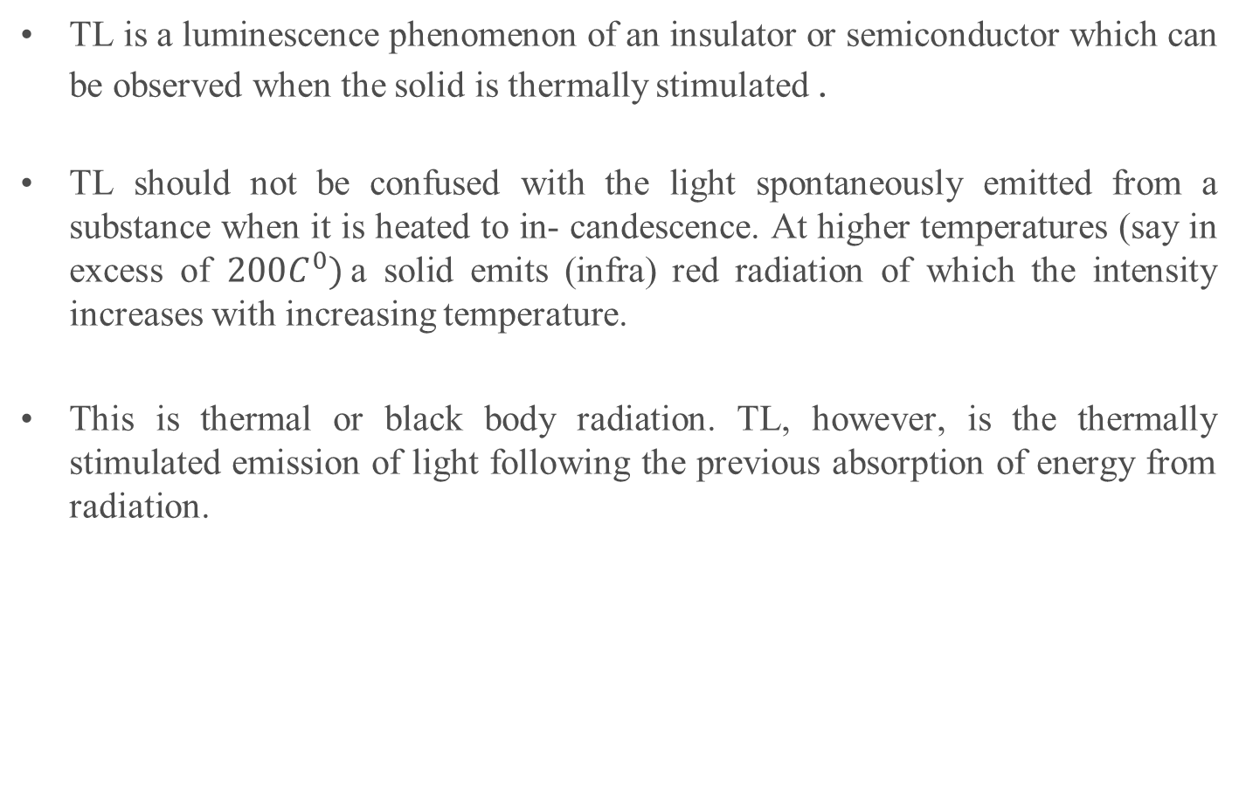
Basic Concepts Of Thermoluminescence

Slide 33
From this description the three essential ingredients necessary for the production of TL can be deduced :
  Firstly, the material must be an insulator or a semiconductor ± metals do not exhibit luminescent properties.
  Secondly, the material must have at some time absorbed energy during exposure to ionizing radiation.
  Thirdly, the luminescence emission is triggered by heating the material

Slide 34
A thermoluminescent material is thus a material that during exposure to ionizing radiation absorbs some energy which is stored. The stored energy is released in the form of visible light when the material is heated.
Note that TL does not refer to thermal excitation, but to stimulation of luminescence in a sample which was excited in a deferent way. This means that a TL material cannot emit light again by simply cooling the sample and reheating it another time.
It should first be re-exposed to ionizing radiation before it produces light again.
The storage capacity of a TL material makes it in principle suitable for dosimetric applications.

Slide 35
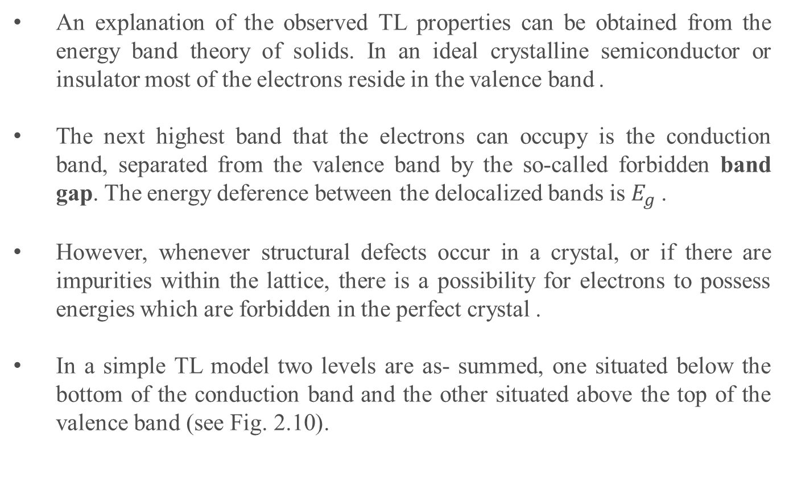
The one trap one centre model

Slide 36
Figure 10 : Energy band model showing the electronic transitions in a TL material according to a simple two-level model: (a) generation of electrons and holes; (b) electron and hole trapping; (c) electron release due to thermal stimulation; (d) recombination. Solid circles are electrons, open circles are holes. Level T is a electron trap, level R is a recombination centre, Ef is Fermi level.

Slide 37
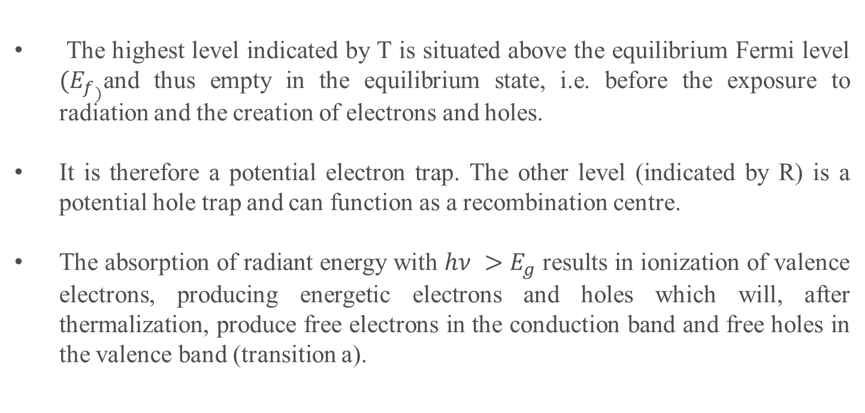

Slide 38
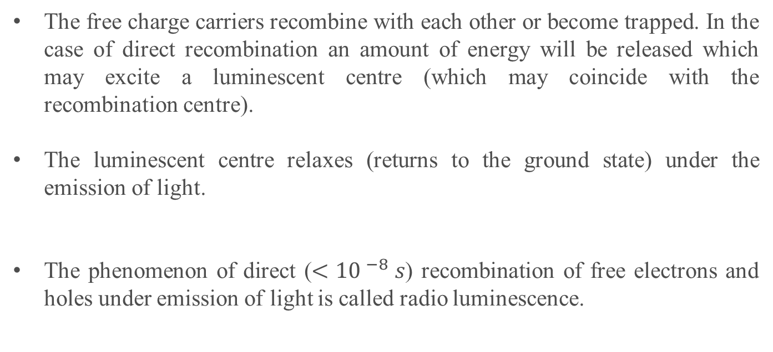

Slide 39
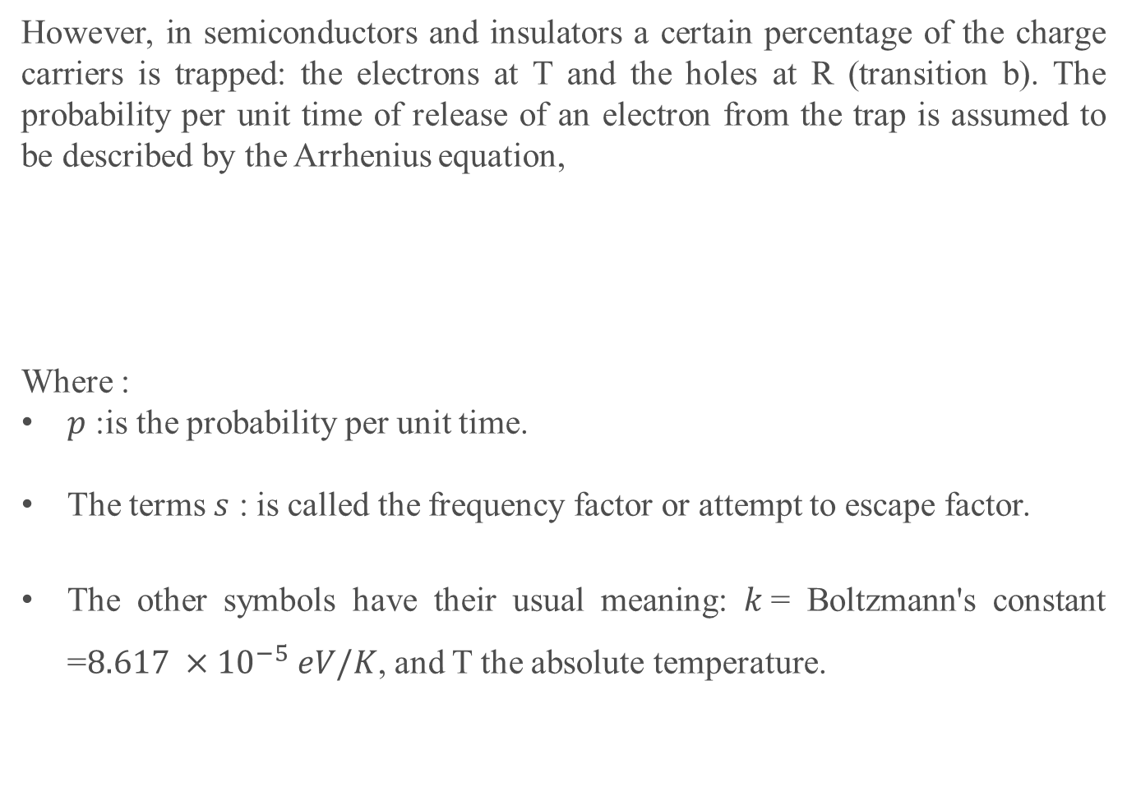

Slide 40
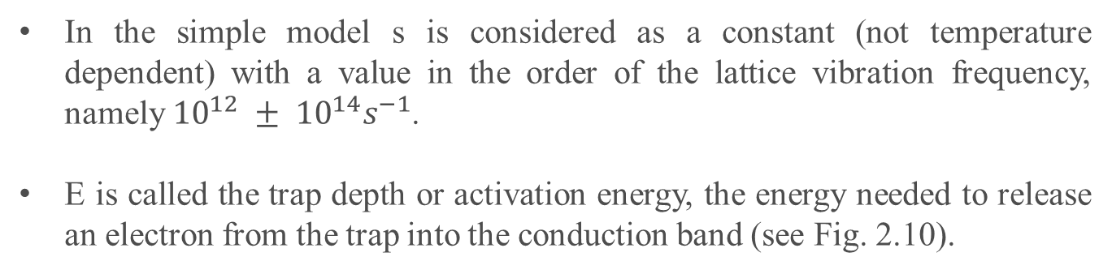
In the simple model s is considered as a constant (not temperature dependent) with a value in the order of the lattice vibration frequency, namely ${10}^{12} ± {10}^{14}s^{−1}$.
E is called the trap depth or activation energy, the energy needed to release an electron from the trap into the conduction band (see Fig. 2.10).

Slide 41
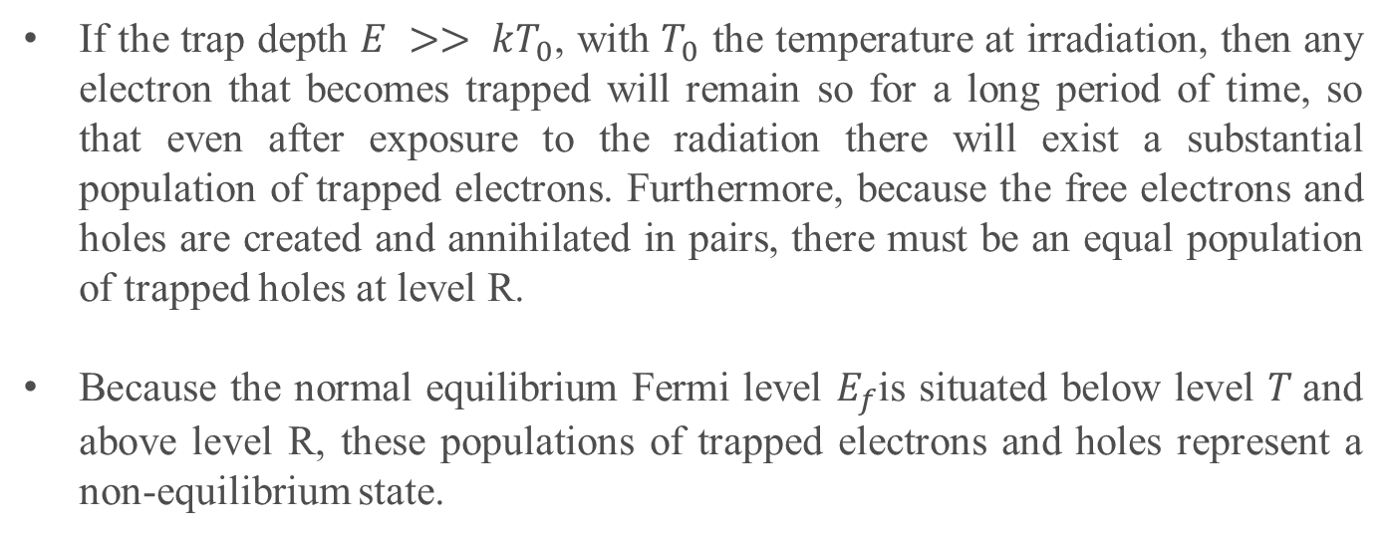

Slide 42
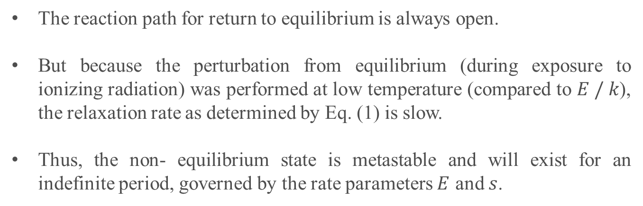

Slide 43
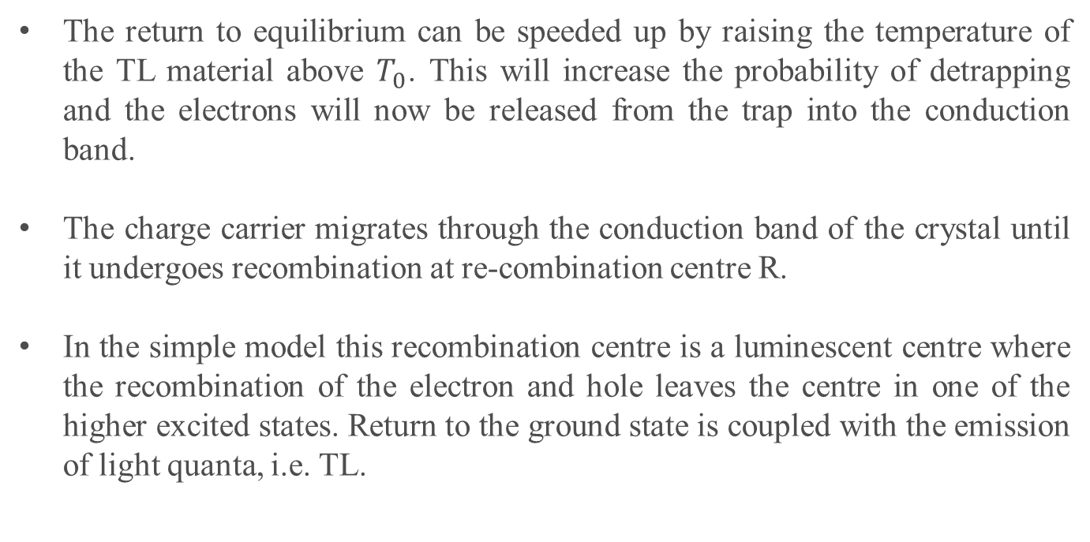

Slide 44
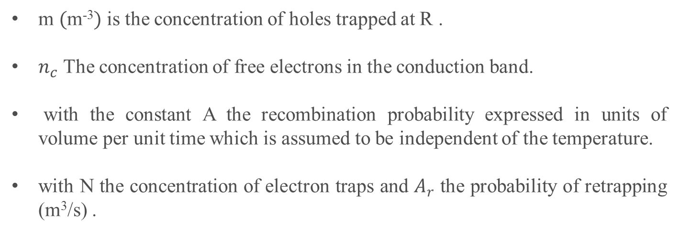
The intensity of TL:
m $($m⁻³$)$ is the concentration of holes trapped at R .
$n_{c}$ The concentration of free electrons in the conduction band.
with the constant A the recombination probability expressed in units of volume per unit time which is assumed to be independent of the temperature.
with N the concentration of electron traps and $A_{r}$ the probability of retrapping (m³/s) .

Slide 45
Applications of TLD
Applications of TLD
Medicine
Biology
and
Related
fields
Reactor
engineering
Personnel
dosimetry
Environmental
monitoring
Radiotherapy measurements
Diagnostic radiology measurements

Slide 46
1. Application of TLD in medicine
I. Radiotherapy measurements
The difficulties of accurately predicting absorbed doses in radiotherapy by calculation have in the past led to the development of in vivo measurement techniques
Thermoluminescence dosimetry has proved a useful technique for a variety of purposes in radiotherapy, including measurements of therapy machine output .
Thermoluminescence dosimetry has proved to be a useful method in the comparison of patient absorbed dose from these new techniques as well as from the more traditional ones.

Slide 47
II. Diagnostic radiology measurements
Diagnostic absorbed dose measurements are important for:
  Improving the design of equipment to reduce patient absorbed dose.
  (ii) Providing a measurement database for epidemiological analysis of population radiation absorbed dose from diagnostic radiology.

Slide 48
2. TLD in biology and related fields
Applications in the following fields are given as
  Animal experiments .
  Bone dosimetry .
  Photon radiation quality measurements .
  Toxicity determinations .
  General biology and biochemistry .
  Ecology.
  Animal habit studies.

Slide 49
3.TLD in reactor engineering
The TLD can be designed to yield the desired response for gamma radiation and can be an effective 'gamma dose equivalent' meter. The neutron response is more complex, and it is most useful for thermal-neutron flux .

Slide 50
4. Application of TLD to personnel
dosimetry
The primary objective of individual monitoring for external radiation is to assess, and thus limit, radiation doses to individual workers.
Supplementary objectives are to provide information about the trends of these doses and about the conditions in places of work and to give information in the event of accidental exposure.
The following quantities should be measured in personnel monitoring :
Skin dose or the surface absorbed dose to assess the dose equivalent to the basal layer of the epidermis at a depth of 5^-10 mg cm^-2.

Slide 51
2. Whole body dose or the dose equivalent at a depth of 400-1000 mg cm^-2 below the surface of the body to assess or over-estimate the effective dose equivalent or the average dose equivalent in the critical organs .
3. Extremity dose to assess the maximum value of the dose equivalent (skin dose) in tissue to any part of the hands, forearms, feet or ankles

Slide 52
5. Application TLD systems for
environmental monitoring
A significant aspect of environmental monitoring is the limitation of radiation exposure values in man from the nuclear power fuel cycle. In the case of gaseous radio nuclides released to the environment from a nuclear installation, the acceptable limit of exposure is based on an annual dose equivalent of 30 mrem .

Slide 53
Advantages of TLDs
They are tissue equivalent.
They have large range of dose .
It can store doses for long periods.
Sensitivity independent of dose rate.
It is no temperature & pressure correction needed.
Tld’s have a precision of approximately 15% for low doses.

Slide 54
They are small in size and therefore they can be used for point dose
measurements.
Chemically inert
It is also reusable; reusability usually reduces cost per reading, so they
are not expensive.
Thermoluminescent dosimeters can measure doses as low as 1 mille rem.
They are available in many forms.

Slide 55
Disadvantages of TLDs
Readout and calibration time consuming,
• Only one time reading during heating, cannot be repeated.
Light sensitivity: TLDs show some sensitivity to light, causing accelerated “fading”, or leakage of filled traps, or ionization and the filling of traps, giving spurious TL readings Serious TL .
Reader instability: TLD readings depend on the light sensitivity of the reader as well as on the heating rate of the phosphor. Thus reader constancy is difficult to maintain over long time periods.
Storage instability: TLD sensitivity can vary with time before irradiation.
Easy to lose reading

Slide 56
conclusion
A thermoluminescent dosimeter, or TLD, is a type of radiation dosimeter. A
TLD measures ionizing radiation exposure by measuring the amount of visible
light emitted from a crystal in the detector when the crystal is heated. The
amount of light emitted is dependent upon the radiation exposure.
The TLD use many of Materials exhibiting thermoluminescence in response
to ionizing radiation include but are not limited to calcium fluoride, lithium
fluoride , calcium sulfate , lithium borate, calcium borate, and potassium
bromide .
It use in many application, it can be used both for environmental monitoring
and for staff personnel in facilities involving radiation exposure, among other
applications.

Slide 57


